Slide 1
AR Indoor Navigation for
SKKU Suwon campus
team E: 김현호 마준서 안정민 조민구

Slide 2
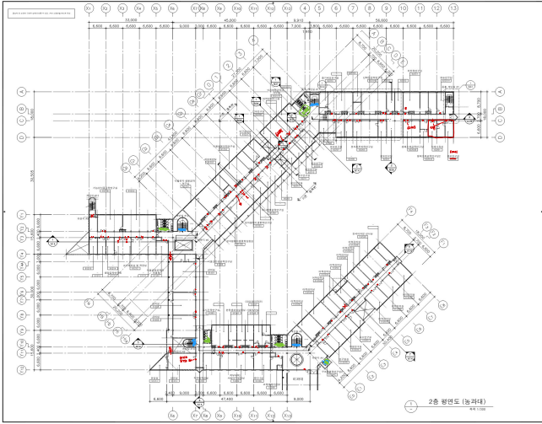
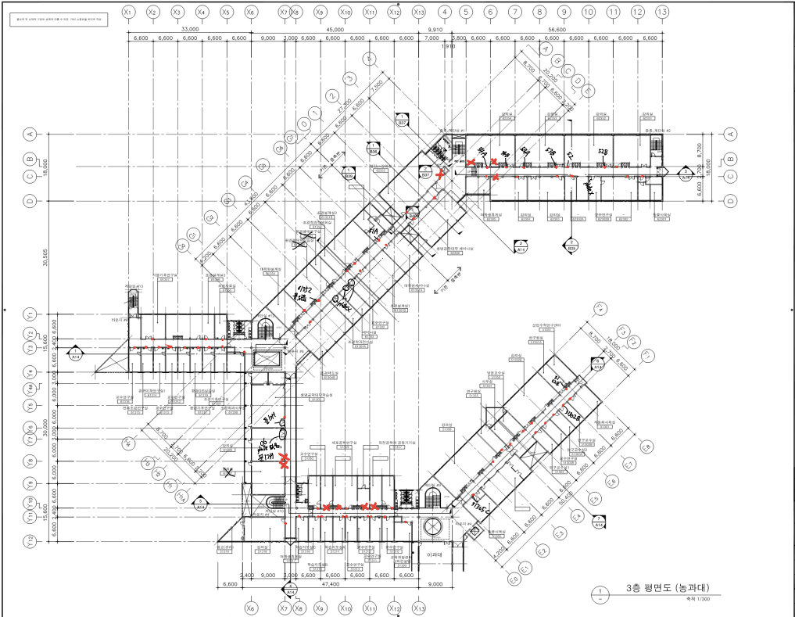
Floor Planning Check (Complete)
1/11
농과대(62동)

Slide 3
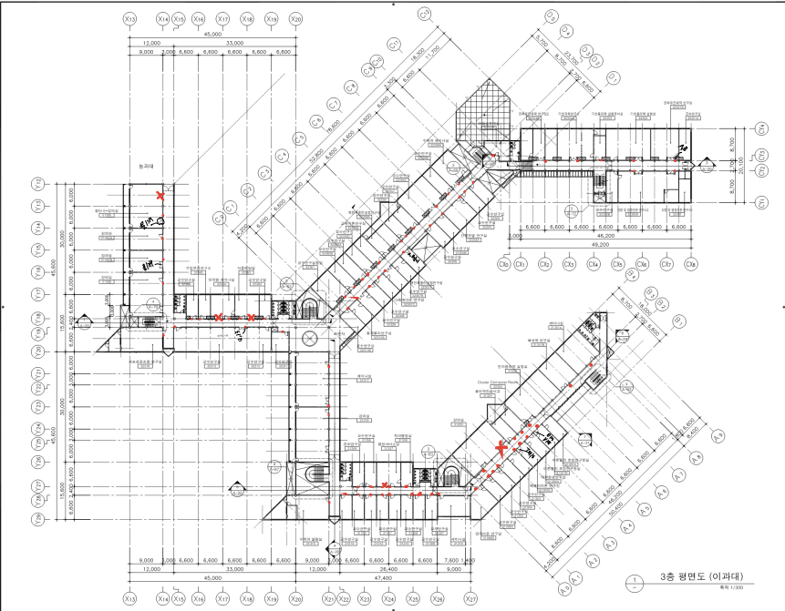
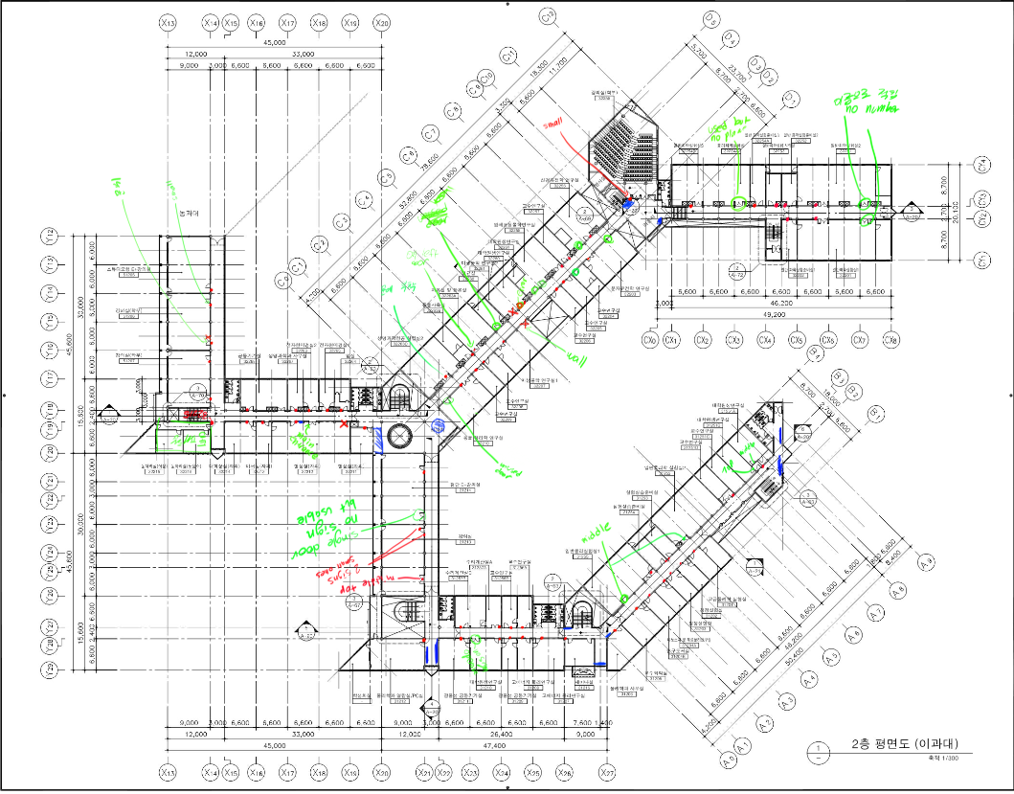
Floor Planning Check (Complete)
2/11
이과대(31동)

Slide 4
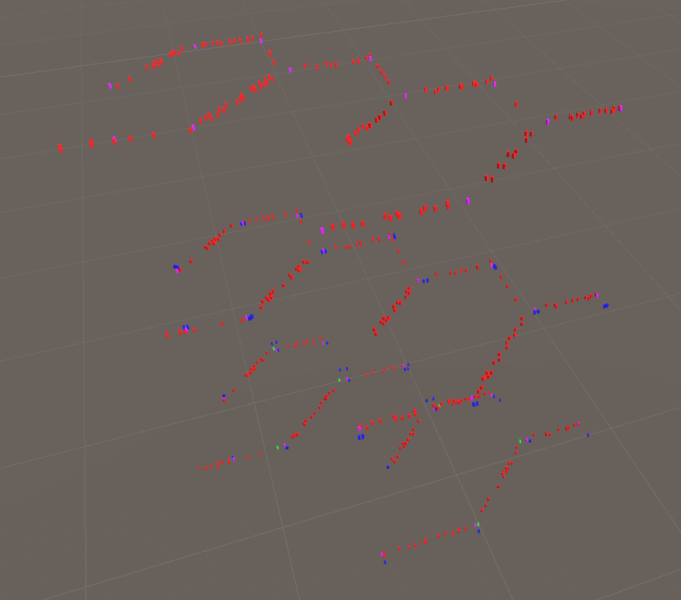
Floor Mapping (Almost Complete)
3/11
Room
Spot for navigation
Stairs
AR Anchor Position(progress)

Slide 5
Updated Features in Main Application
4/11
AR Marker Recognition
Scan Door Plate and compare with map data
AR Anchor Host and Resolve
Host AR anchor and save id to clipboard
Set Origin and Destination
Set place with UI

Slide 6
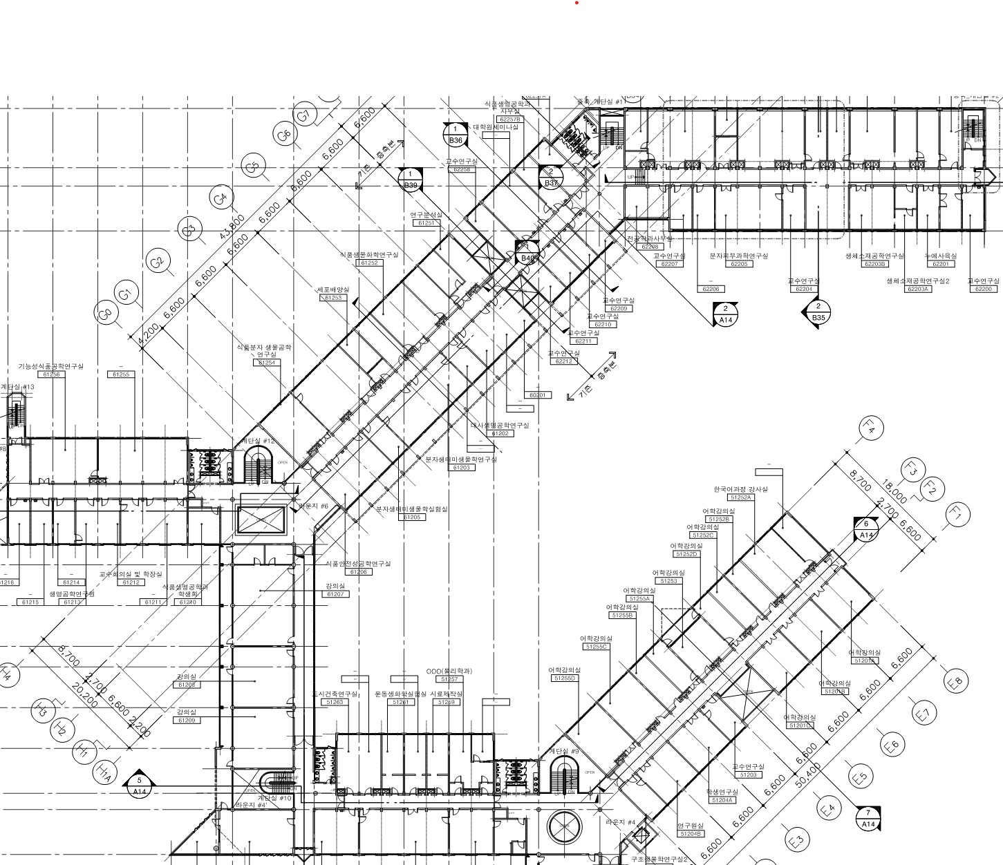


Current Progress: Navigation System Concept
5/11
Starting Position
Hallway 1
Corridor 1
Hallway 2
Corridor 2
END Position

Slide 7
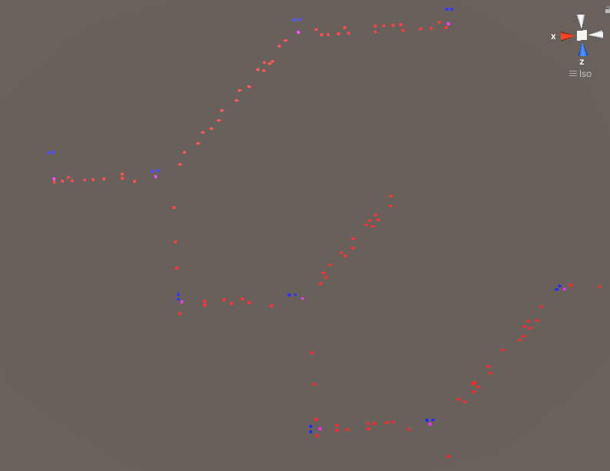
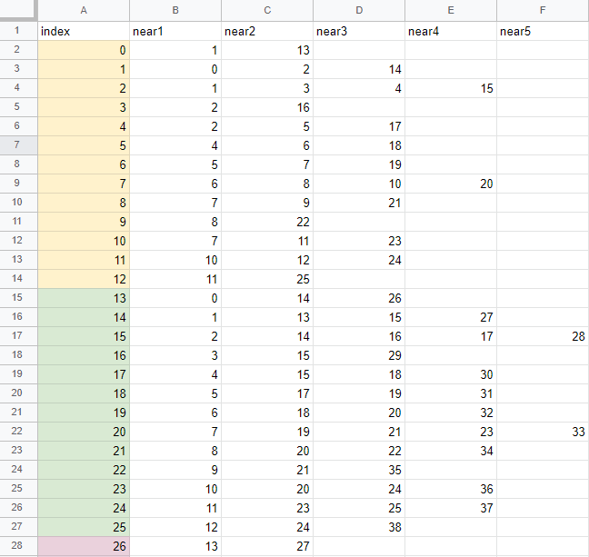
Current Progress: Navigation System Concept
6/11

Slide 8
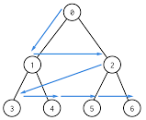

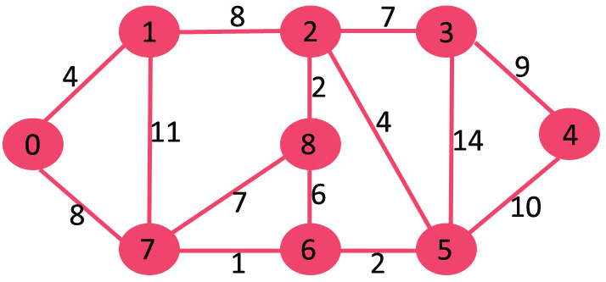
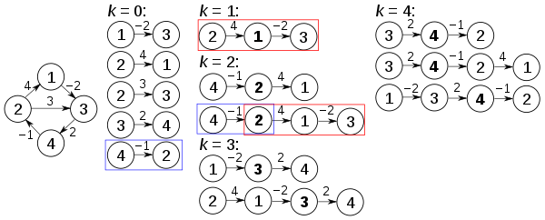
Current Progress: Navigation Algorithm (Complete)
7/11
Considered Algorithms
BFS(breadth First Search)
Bellman-Ford-Moore
Dijkstra Algorithm
Floyd-Warshall

Slide 9
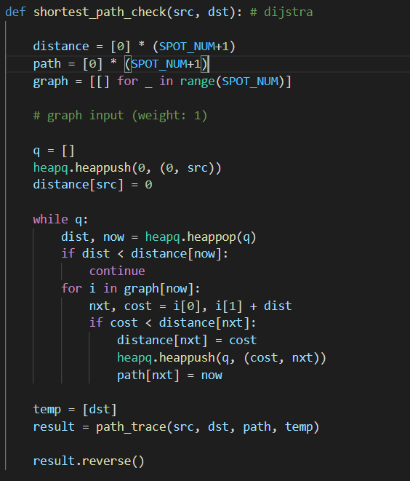
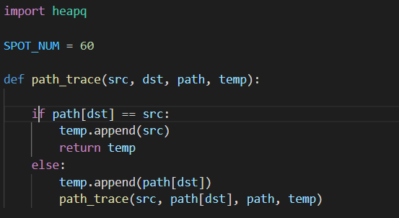
Current Progress: Navigation Algorithm (Complete)
8/11
Dijkstra Algorithm

Slide 10
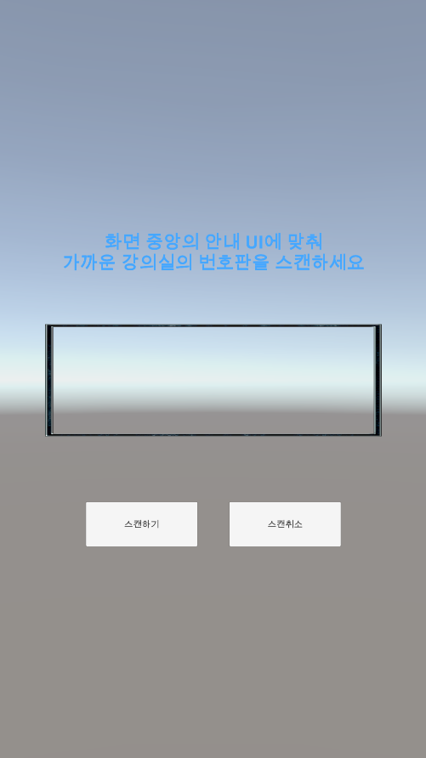
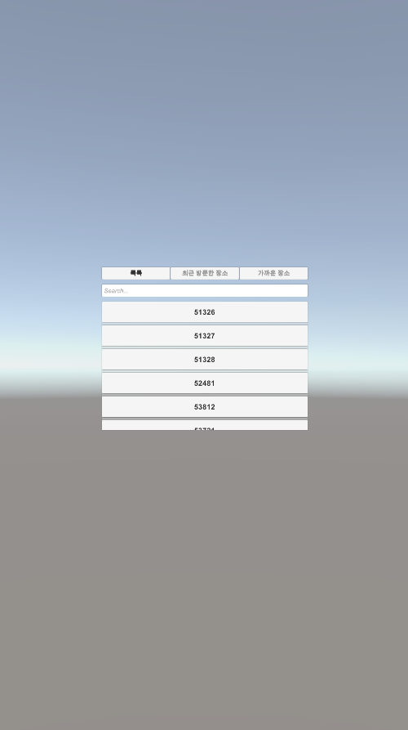
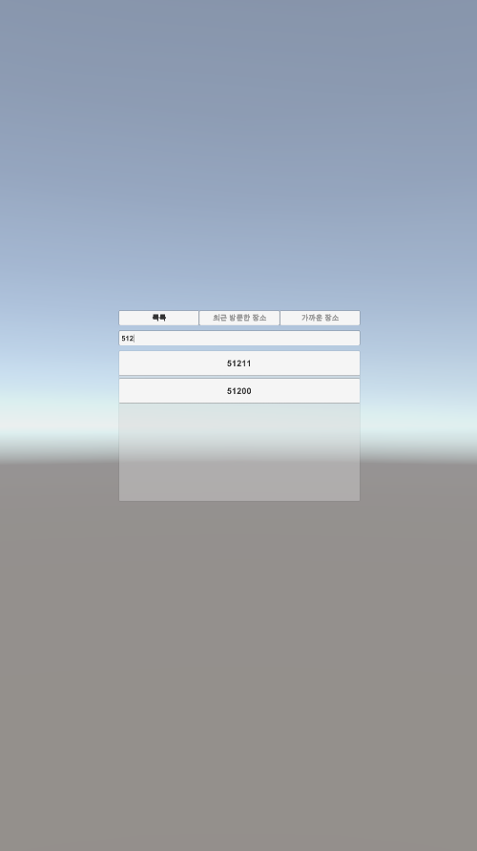
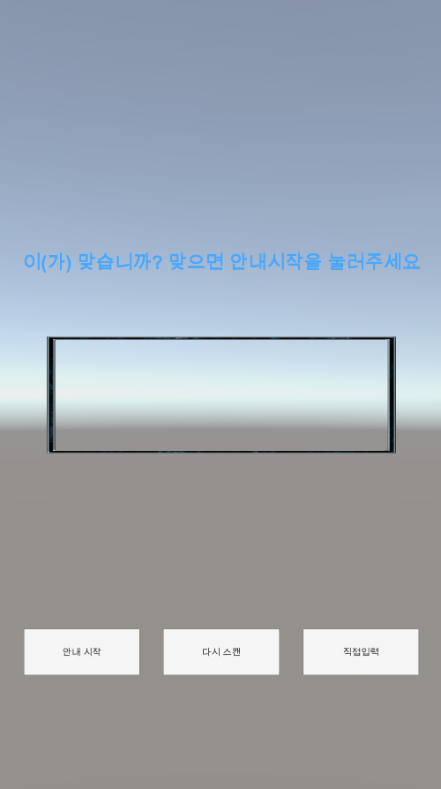
Current Progress: Front-end (Semi-Complete)
9/11

Slide 11
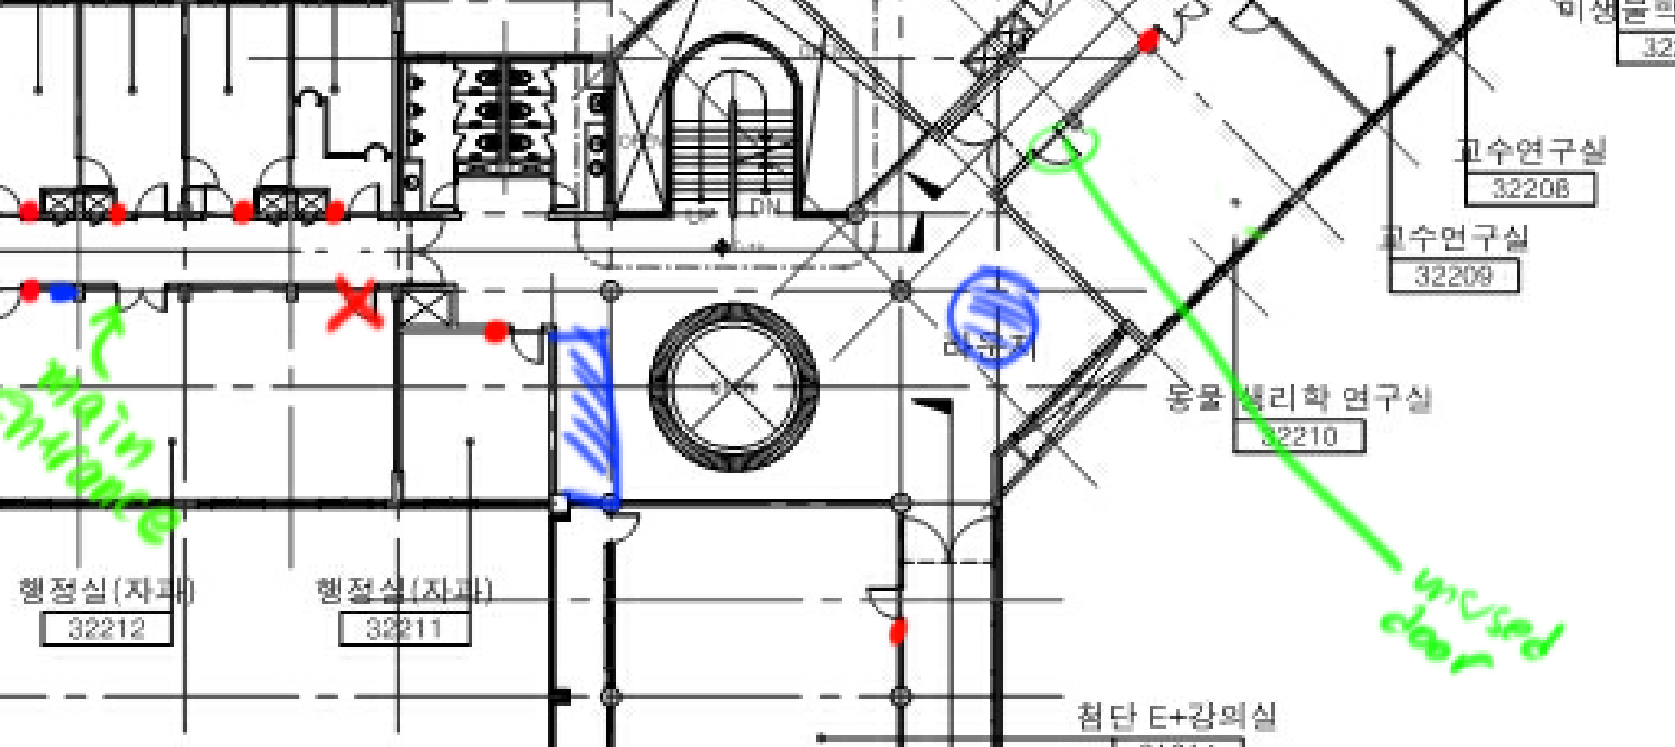
ToDo: Anchor Mapping and Location Correction
10/11

Slide 12
11/11
To-do List
Implementation of Navigation Algorithm to Front-end
Anchor Mapping
Simple Navigation Test

